Slide 1
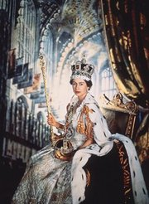
Praying For Governments

Slide 2
It Is Our Duty
1 Timothy 2:1-4 MKJV First of all, then, I exhort that supplications, prayers, intercessions, and giving of thanks be made for all men, (2) for kings and all who are in authority, so that we may lead a quiet and peaceable life in all godliness and reverence. (3) For this is good and acceptable in the sight of God our Savior, (4) who will have all men to be saved and to come to the knowledge of the truth.

Slide 3
It Is God’s Concern
Riches , Honour, Greatness and Strength
(1 Chronicles 29:11-12 NKJV) {11} Yours, O LORD, is the greatness, The power and the glory, The victory and the majesty; For all that is in heaven and in earth is Yours; Yours is the kingdom, O LORD, And You are exalted as head over all. {12} Both riches and honor come from You, And You reign over all. In Your hand is power and might; In Your hand it is to make great And to give strength to all.
Political Position
(Daniel 4:17 NKJV) ..In order that the living may know That the Most High rules in the kingdom of men, Gives it to whomever He will, And sets over it the lowest of men.'

Slide 4
The Spiritual Battle
Daniel 10:11-14 MKJV And he said to me, O Daniel, a man greatly beloved, understand the words that I speak to you, and stand upright. For to you I am now sent. And when he had spoken this word to me, I stood trembling. (12) Then he said to me, Do not fear, Daniel; for from the first day that you set your heart to understand and to chasten yourself before your God, your words were heard. And I have come for your words. (13) But the ruler of the kingdom of Persia withstood me twenty-one days. But lo, Michael, one of the chief rulers, came to help me; and I remained there with the kings of Persia. (14) Now I have come to make you understand what shall happen to your people in the latter days. For the vision is yet for many days.

Slide 5
Satan’s Claim
Luke 4:5-8 MKJV And the Devil, leading Him up into a high mountain, showed Him all the kingdoms of the world in a moment of time. (6) And the Devil said to Him, All this power I will give you, and the glory of them; for it has been delivered to me. And I give it to whomever I will. (7) Therefore if you will worship me, all shall be yours. (8) And Jesus answered and said to him, Get behind me, Satan! For it is written, "You shall worship the Lord your God, and Him only shall you serve.“
1 John 5:18-19 ISV We know that the person who has been born from God does not go on sinning. Rather, the Son of God protects them, and the evil one cannot harm them. (19) We know that we are from God and that the whole world lies under the control of the evil one.

Slide 6
God’s Response
Revelation 11:15-19 ISV (15) When the seventh angel blew his trumpet, there were loud voices in heaven, saying, "The kingdom of the world has become the kingdom of our Lord and of his Christ, and he will rule forever and ever." (16) Then the twenty-four elders who were sitting on their thrones in God's presence fell on their faces and worshiped God. (17) They said, "We give thanks to you, Lord God Almighty, who is and who was, because you have taken your great power and have begun to rule. (18) The nations were angry, but your wrath has come. It is time for the dead to be judged- to reward your servants, the prophets, the saints, and all who fear your name, both unimportant and important, and to destroy those who destroy the earth." (19) Then the temple of God in heaven was opened, and the ark of his covenant was seen inside his temple. There were flashes of lightning, noises, peals of thunder, an earthquake, and heavy hail.

Slide 7
Our Involvement
Revelation 1:4-6 HCSB John: To the seven churches in the province of Asia. Grace and peace to you from the One who is, who was, and who is coming; from the seven spirits before His throne; (5) and from Jesus Christ, the faithful witness, the firstborn from the dead and the ruler of the kings of the earth. To Him who loves us and has set us free from our sins by His blood, (6) and made us a kingdom, priests to His God and Father--to Him be the glory and dominion forever and ever. Amen.
Revelation 5:9-10 HCSB And they sang a new song: You are worthy to take the scroll and to open its seals; because You were slaughtered, and You redeemed people for God by Your blood from every tribe and language and people and nation. (10) You made them a kingdom and priests to our God, and they will reign on the earth.
Revelation 2:26-27 ASV And he that overcometh, and he that keepeth my works unto the end, to him will I give authority over the nations: (27) and he shall rule them with a rod of iron, as the vessels of the potter are broken to shivers; as I also have received of my Father:

Slide 8
Ekklesia
The Church
Ekklesia was also the form of city government in Athens.
The Church is the Kingdom of God in the midst of the city
The Church derives part of its identity from the city e.g. “the ekklesia in Corinth”.

Slide 9
Polis
The City
The political life
The community or civilization
Church members come from the Polis
The city also has its “gods” and its festivals and may be linked to a ruling power or principality e.g. Artemis of the Ephesians

Slide 10
Kosmos
The “World System” consisting of powers and principalities. The “Age” (aion)
Ephesians 6:12 For we do not wrestle against flesh and blood, but against principalities, against powers, against the rulers of the darkness of this age, against spiritual hosts of wickedness in the heavenly places.

Slide 11
Stoichea
The “measured out things”, the “elements”
The rules of the “kosmos” - the spiritual rules, fears, rituals, human commandments, superstitions and ceremonies that keep people in spiritual bondage.
(Colossians 2:8-23, Galatians 4:9,10
This or that is “taboo”
Community governed and kept in darkness
Overcome on the cross.

Slide 12
Ouranos
Heaven/s
First Heaven – birds fly
Second heaven – angels fly and do battle
Third heaven – worship and adoration of God
Jesus “passed through the Heavens”
Satan is presently in the 1st Heaven as “prince of the power of the air”.

Slide 13
Theos
God
Jesus at the right-hand side of God.
Christians are seated with Him (Ephesians 2:6)
We have ascended with Christ.
We are over and above the principalities and powers
We have “son of God” status.

Slide 15
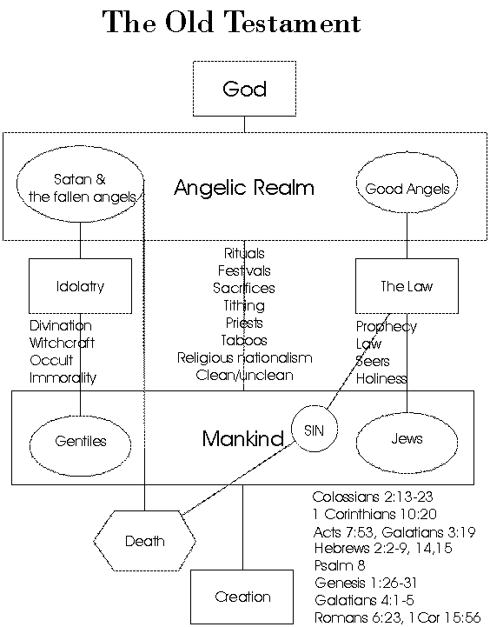

Slide 16
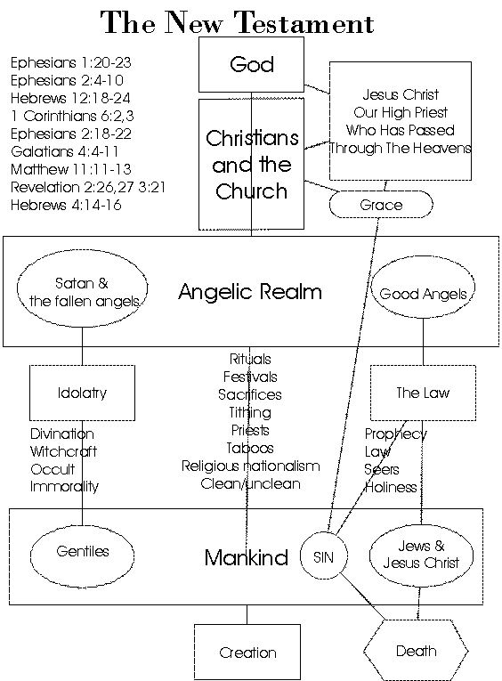

Slide 17
Citizens of Heaven
Christians are citizens of the Polis
And citizens of Heaven
The Church is both located in society and in Heaven.
The Church can bring the powers of Heaven to earth on healing, deliverance and gospel proclamation. (Luke 10)

Slide 18
Redemption
For the ekklesia to redeem the polis it has to wrestle against the kosmos
and overthrow the grip of the superstitions of the stoichea on the population.
This may invoke a reaction at the level of the community and its political leaders – e.g. Acts 16 – Paul in Philippi and Acts 19 Paul in Ephesus

Slide 19
Backsliding
The Church can come under the grip of the kosmos by observing the stoichea e.g. circumcision debate and food debates.
Colossians 2:8-23, Galatians 4:9-11, 5:1-11
“Religion” that imitates OT structures or pagan structures is a going back to the old and is forbidden. (Galatians 5:1-11 and whole book of Hebrews)

Slide 20
Victory
When the Church is victorious the ekklesia rules the polis and the powers of the kosmos are cast down and there is revival
and objects associated with the stoichea are destroyed (Acts 19)
The political structures are then liberated to be righteous

Slide 21
Victory 2
A righteous King can transform the Temple (Josiah)
And a righteous prophet can transform the Kingship. (Nathan)
There is thus a synergy between the ekklesia and the polis

Slide 22
Leaders
Leaders are the gatekeepers of the culture.
They determine if the gospel can legally be proclaimed.
They encourage or discourage righteousness and truth.
Satan seeks to deceive leaders so as to make war against God. (Revelation 16:13,14 20:3,8)

Slide 23
Spirituality
The spirituality of the leader often affects the whole nation e.g. good and bad kings of Israel.
The church must redeem the leaders if it is to fully redeem the culture.
We are to pray for kings and all in authority as a matter of “first importance” (1 Timothy 2:1-4)
We are also to lead them to Christ where possible.

Slide 24
Spirituality 2
The ekklesia contains wisdom from God that the leaders of the polis need to hear and understand. ( 1 Corinthians 1 & 2)
The ekklesia is supposed to guide the polis.
Where input is possible the Church should guide the State into God’s will.

Slide 25
Psalm 72:2,3
Give the king your justice, O God, and your righteousness to a king's son. (v. 2)
Lord, help our king (president, prime minister) to judge Your people with righteousness. Give us a just government and our leaders the discernment of right and wrong that only You can give.
May the mountains yield prosperity for the people, and the hills, in righteousness. (v. 3) Father, please prosper our nation, and assure that the people also benefit from Your gracious gifts - and not just the leadership.

Slide 26
Psalm 72:4,5
May he defend the cause of the poor of the people, give deliverance to the needy, and crush the oppressor. (v. 4) Merciful God, lead our government to defend the cause of the needy. Give our leaders the moral fortitude to crush oppressors and to stand up to wicked people who use their power against the poor.
May he live while the sun endures, and as long as the moon, throughout all generations. (v. 5) Giver of Life, bless our leader with good health and keep our leader safe from all forms of violence and from all evil.

Slide 27
Psalm 72:6,7
May he be like rain that falls on the mown grass, like showers that water the earth. (v. 6) Work through our leaders to bring refreshment to the people, Lord; may their rule be a source of goodness, blessing, and growth.
In his days may righteousness flourish and peace abound, until the moon is no more. (v. 7) God of all wisdom, inspire our leader to lead in ways that provide enduring peace, stability and a well-founded and lasting moral order.

Slide 28
Psalm 72:8-14
May he have dominion from sea to sea, and from the River to the ends of the earth. May his foes bow down before him, and his enemies lick the dust. May the kings of Tarshish and of the isles render him tribute, may the kings of Sheba and Seba bring gifts. May all kings fall down before him, all nations give him service. (vss. 8-11) Our God and King, help our leaders to serve You well, so that our government is not humiliated by other nations, but instead is honored by all.
For he delivers the needy when they call, the poor and those who have no helper. He has pity on the weak and the needy, and saves the lives of the needy. From oppression and violence he redeems their life; and precious is their blood in his sight. (vss. 12-14) Holy Spirit, convict our government leaders of the preciousness of every human life. Give them active compassion toward the poor, helpless, weak, and needy so that they will consider themselves servants of the people and will despise no one.

Slide 29
Psalm 72:15,16
Long may he live! May gold of Sheba be given to him. May prayer be made for him continually, and blessings invoked for him all day long. (v. 15) Lord of all, move our hearts to pray continually for our leaders and to bless them whenever they come to mind. Especially bless them with the greatest blessing of all—Your salvation.
May there be abundance of grain in the land; may it wave on the tops of the mountains; may its fruit be like Lebanon; and may people blossom in the cities like the grass of the field. (v. 16) Father, give our nation an abundance of basic necessities and food so that it may also bless those that have none. Bless our land so that the people will flourish.

Slide 30
Psalm 72:17-20
May his name endure forever, his fame continue as long as the sun. May all nations be blessed in him; may they pronounce him happy. (v. 17) Lord, when our leaders obey Your laws, You respond with blessing. May the blessings of obedience come to our leaders. Then they will gain international reputation and can witness to the world of Your goodness to those who follow You.
Blessed be the Lord, the God of Israel, who alone does wondrous things. Blessed be his glorious name forever; may his glory fill the whole earth. Amen and Amen. The prayers of David son of Jesse are ended. (vss. 18-20) We praise You, God, for only You can work the wonders that result in the transformation of people and nations. May Your glory indeed fill the earth, including our nation!

